Slide 1

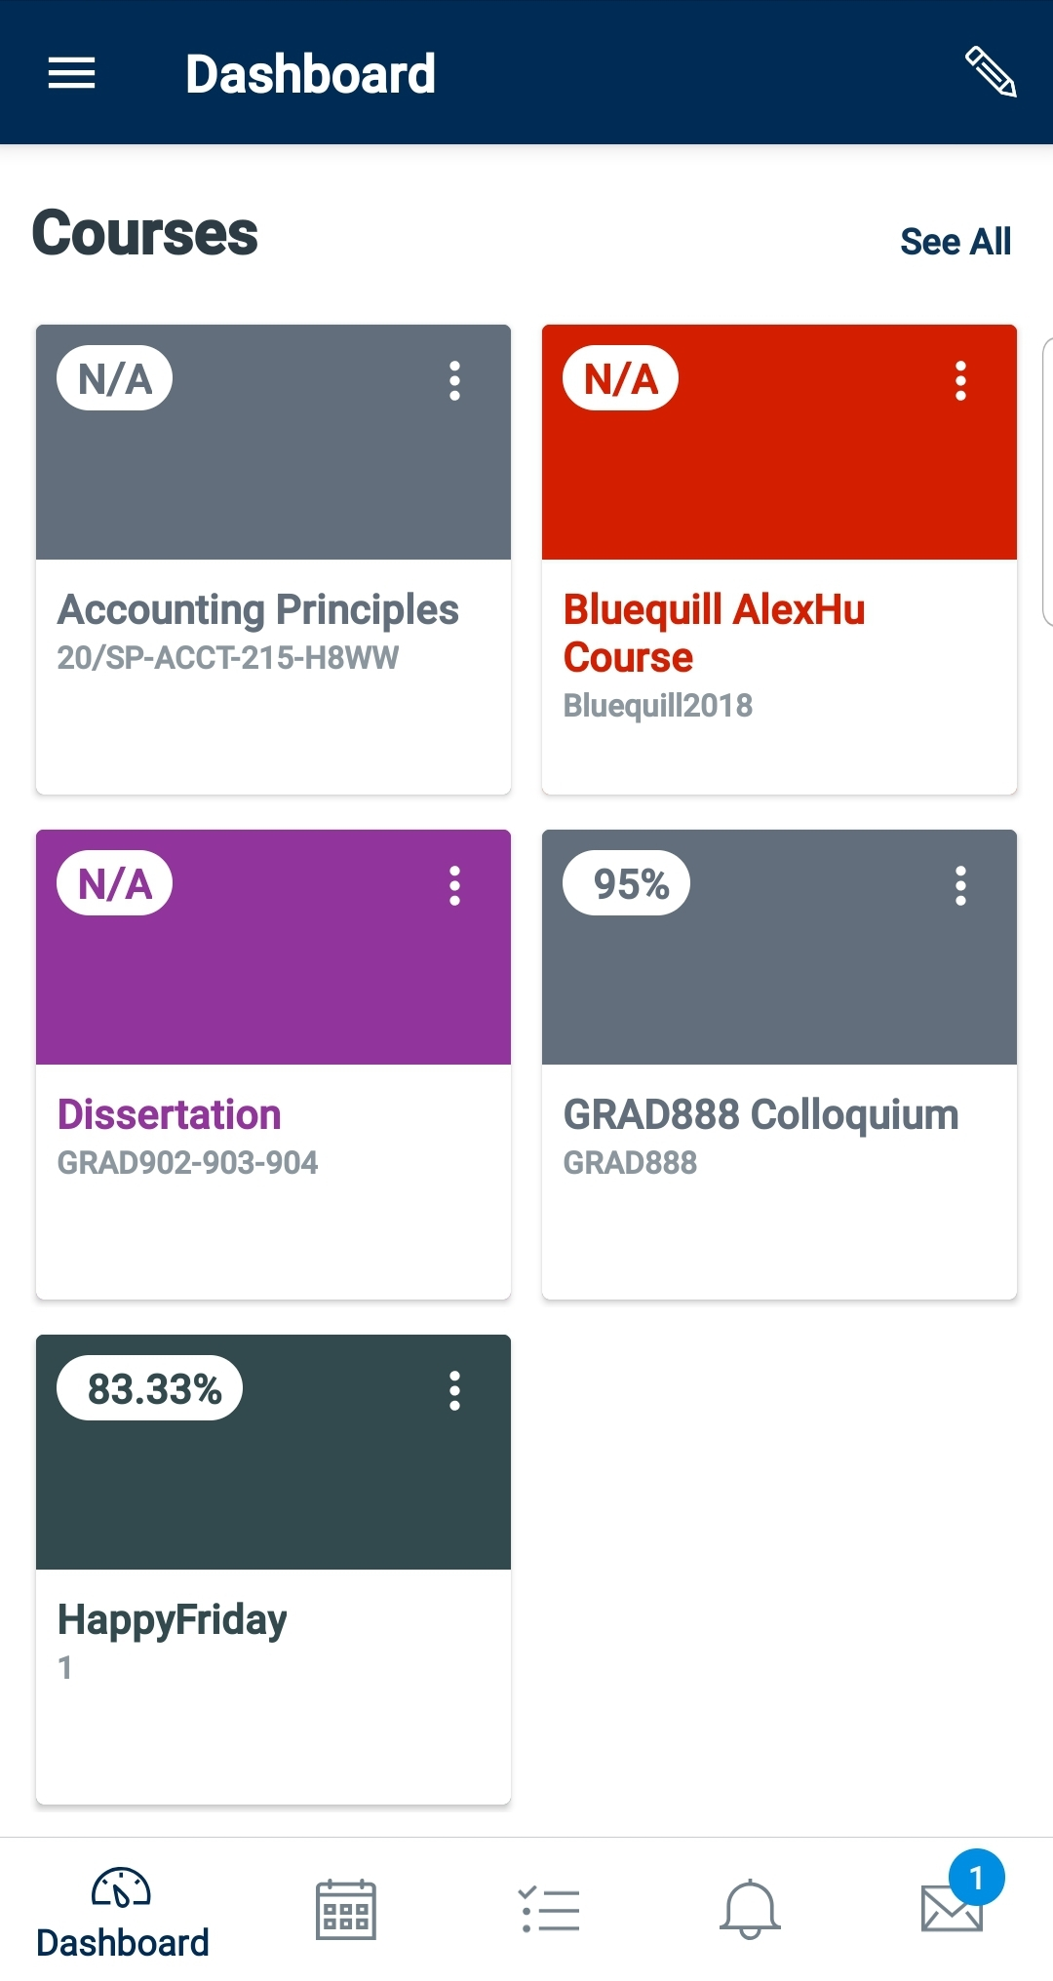

December 4, 2024
Krish Devnani & Rachel Foong
Students, The University of Texas at Austin

Slide 2
Table of Contents
Introduction
ER Diagram
Queries
Normalization
Procedures
Challenges & Future Approaches
Conclusion

Slide 3
Introduction
About Canvas:
Key Stakeholders:
Purpose:
Designed to support universities by shifting information management and academic resources in an online environment
Support all stakeholders engaging with academic content within the institution.
3 Key Entities
Students
Instructors
Teaching Assistants
Stakeholders are able to engage with one another in an enhanced educational experience.
Create an efficient and interconnected platform for these key stakeholders.
They serve as the foundation for the Canvas system, creating a user-friendly experience.

Slide 4
1st ER Diagram
16 Entities with ∼8 Attributes each
3 Key Stakeholder Entities:
Students
Instructors
Teaching Assistants
13 Remaining Entities:
Course
Exams
Grades
Assignments
Discussion Groups
Attendance Records
Resources
Modules
Course Announcements
Office Hours
Feedback
Profile
Notifications

Slide 5
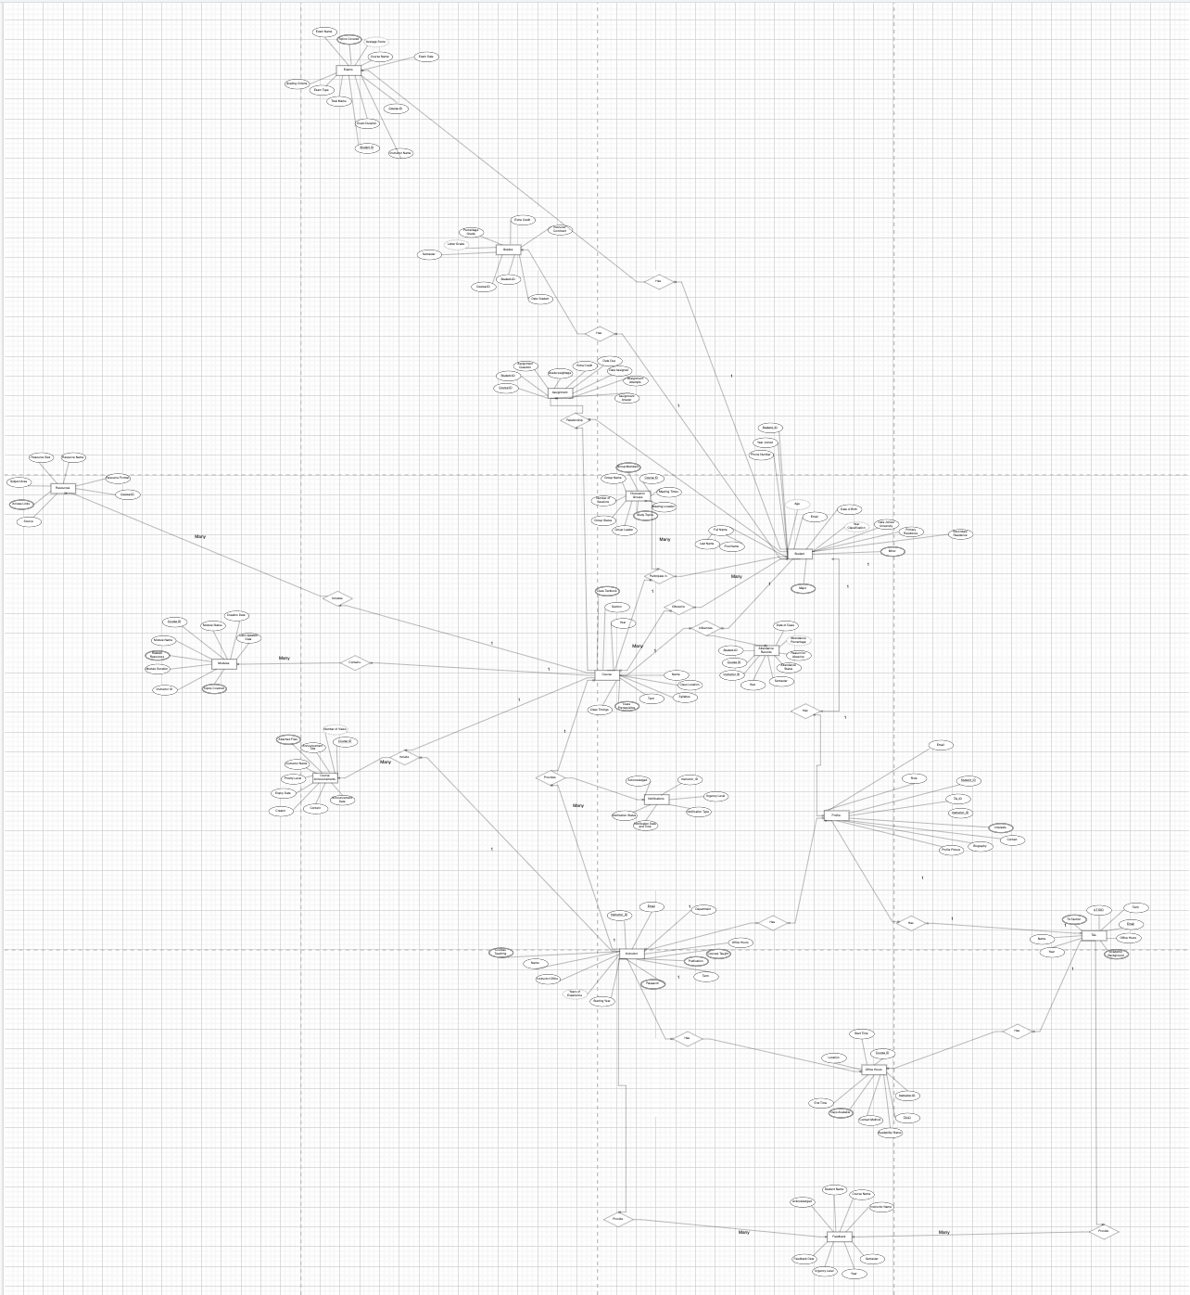

Slide 6
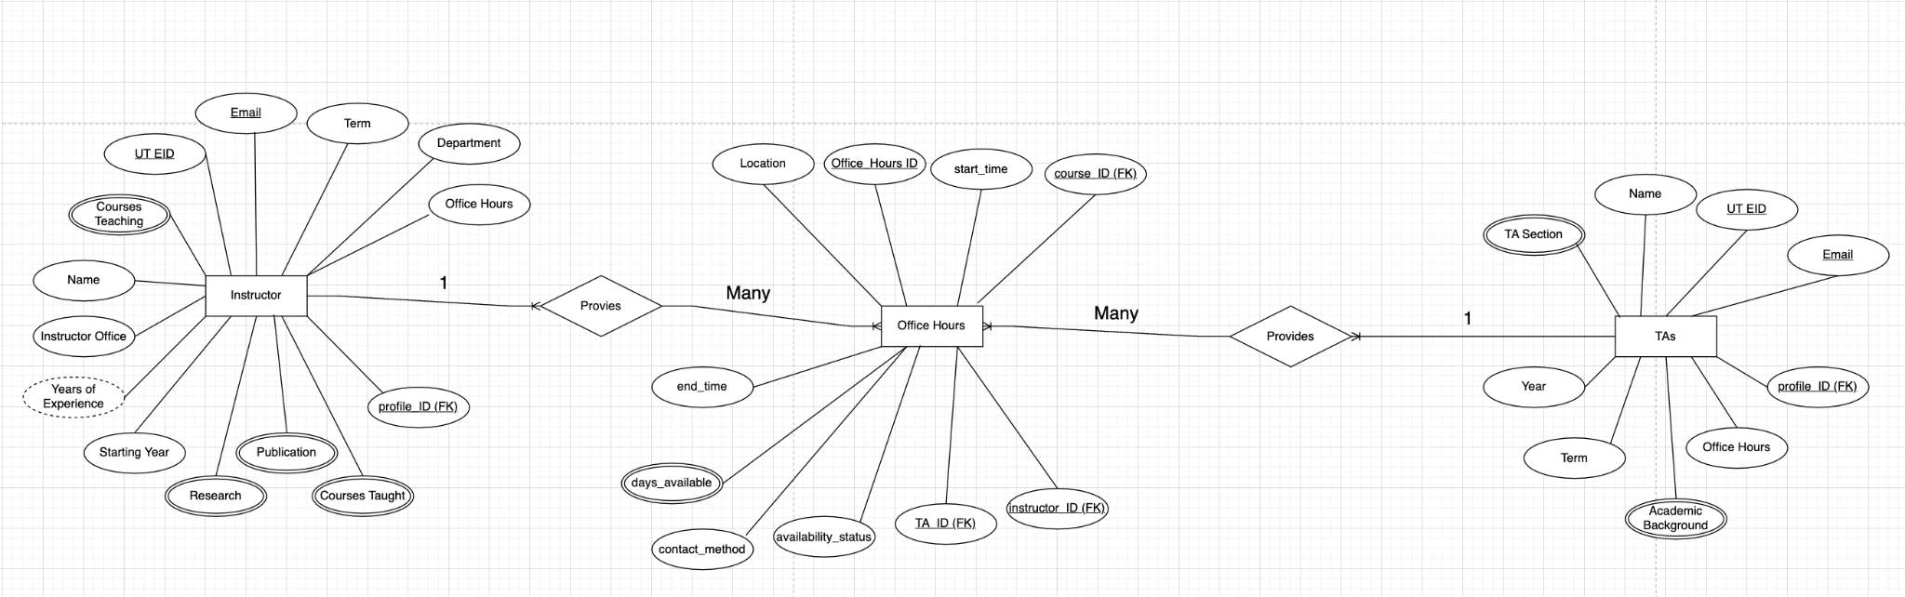
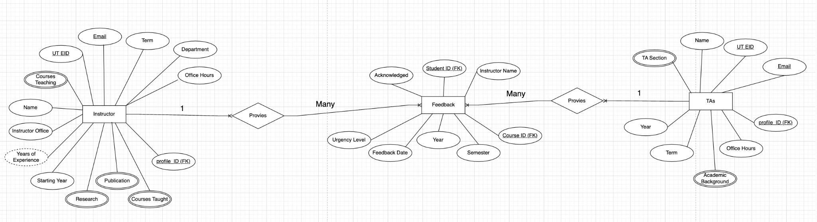
ER Diagram

Slide 7
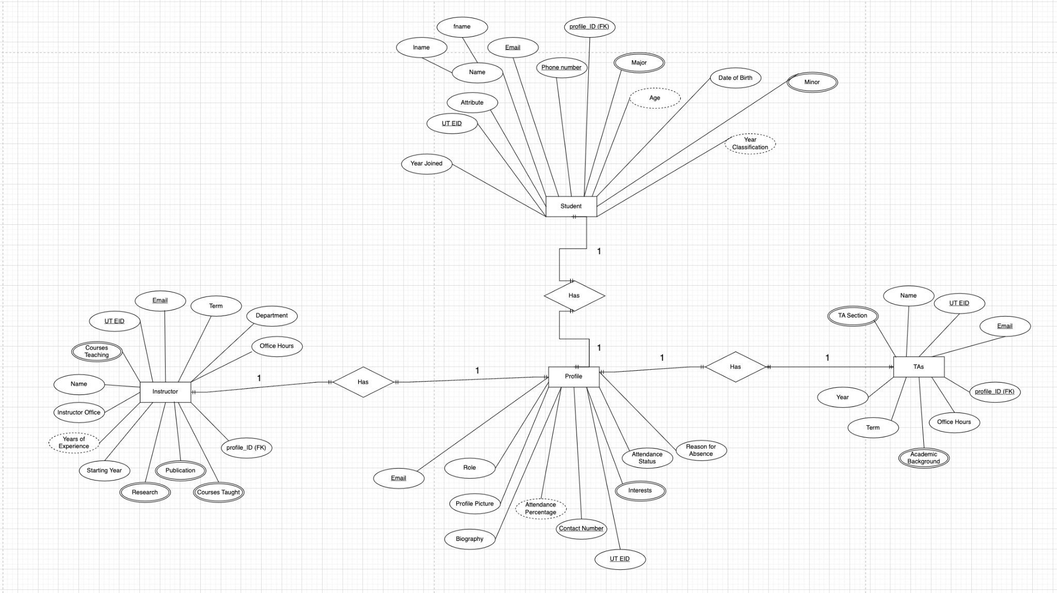
ER Diagram

Slide 8
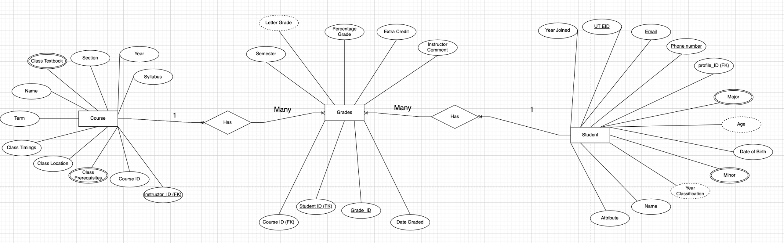
ER Diagram

Slide 9
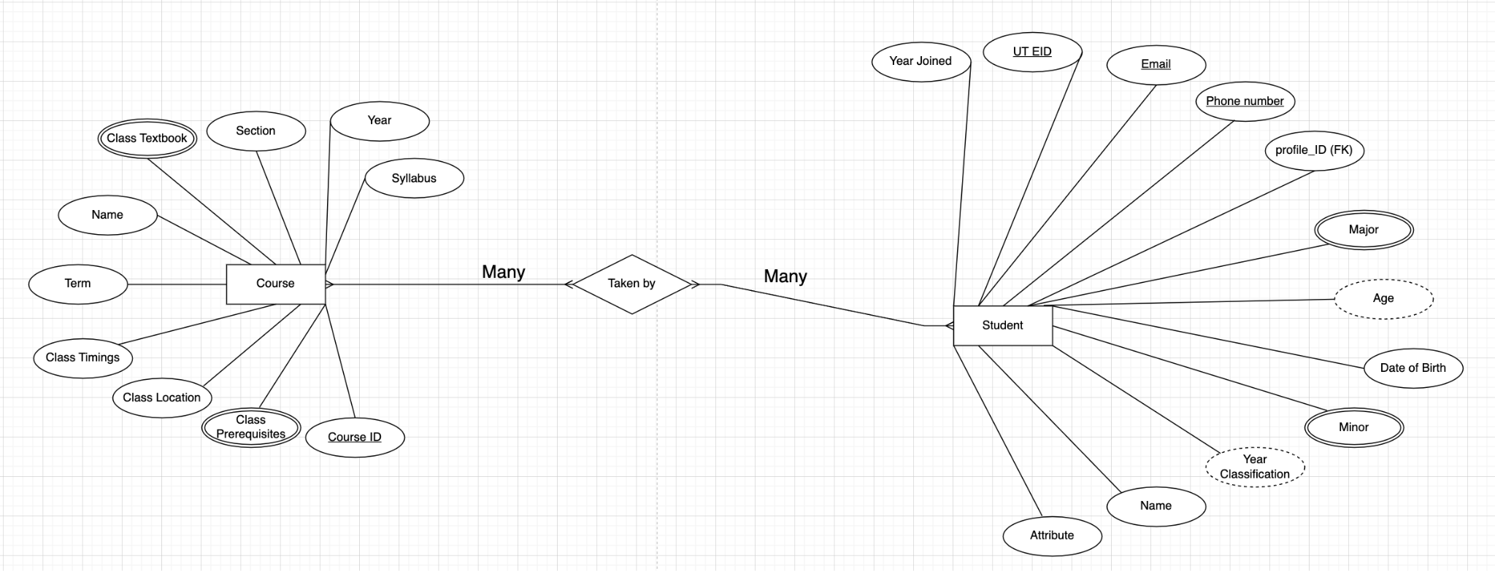
ER Diagram

Slide 10
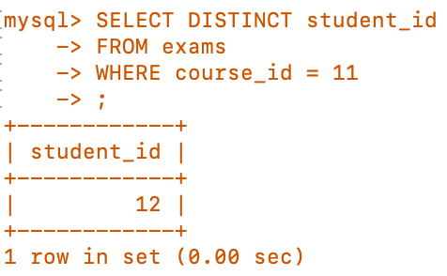
Simple Queries 1
Display all Student IDs who have given an exam for course_id = 11
πstudent_id​(σcourse_id=11​(exams))

Slide 11
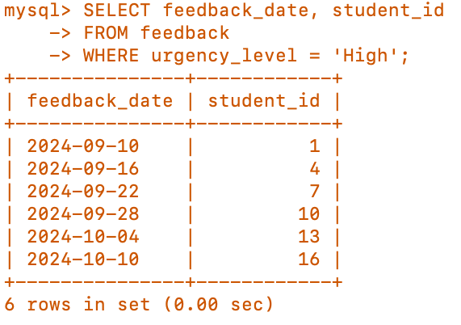
Simple Queries 2
Identify students who require urgent feedback, along with the deadline for responding to them.
πfeedback_date,student_id​(σurgency_level=′High′​(feedback))

Slide 12
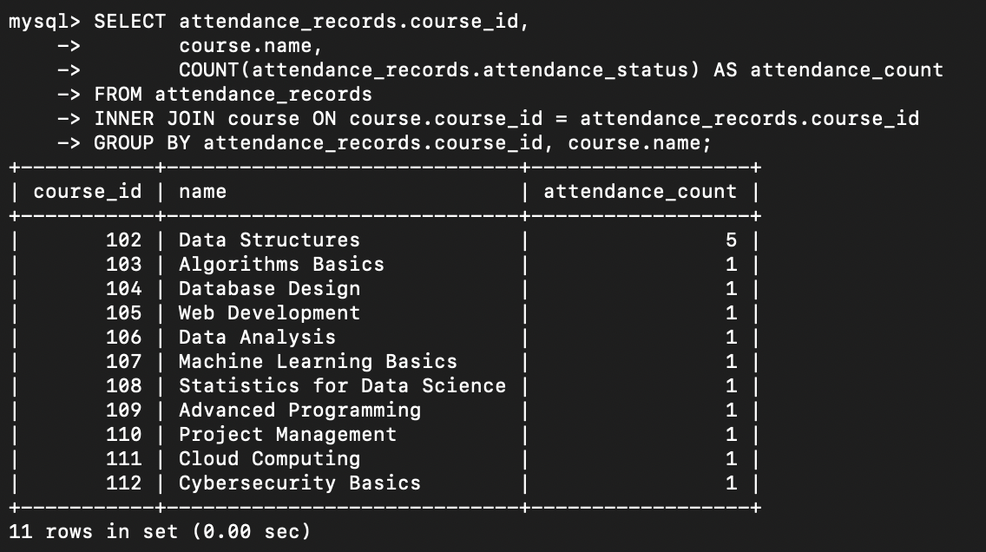
Complex Queries 1
Display course id and and course name in the attendance records

Slide 13
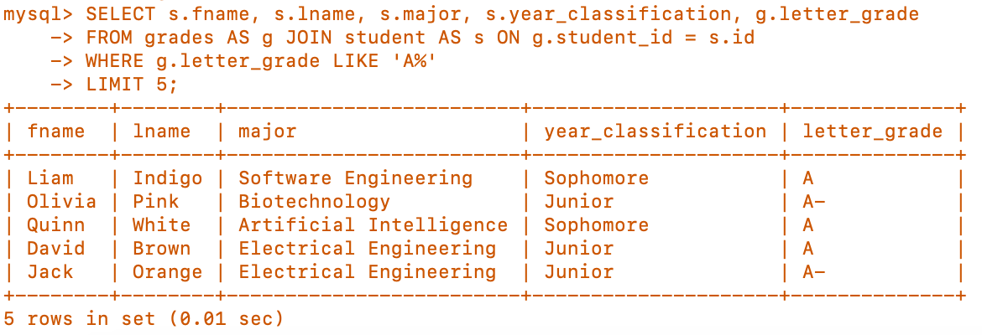
Complex Queries 2
Identify the top 5 students (A), and display their first and last names, majors, and year classifications

Slide 14
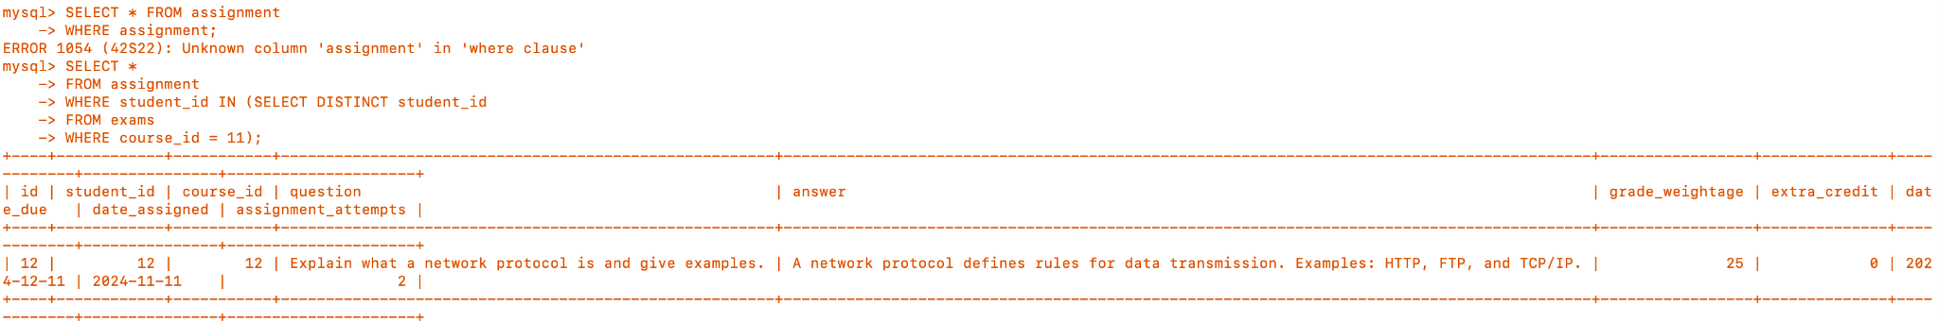
Aggregate Functions & Subqueries
The purpose of this is to identify all of the assignments a student has taken if they have just done an exam for course_id = 11. This is used for pattern recognition in other tables

Slide 15
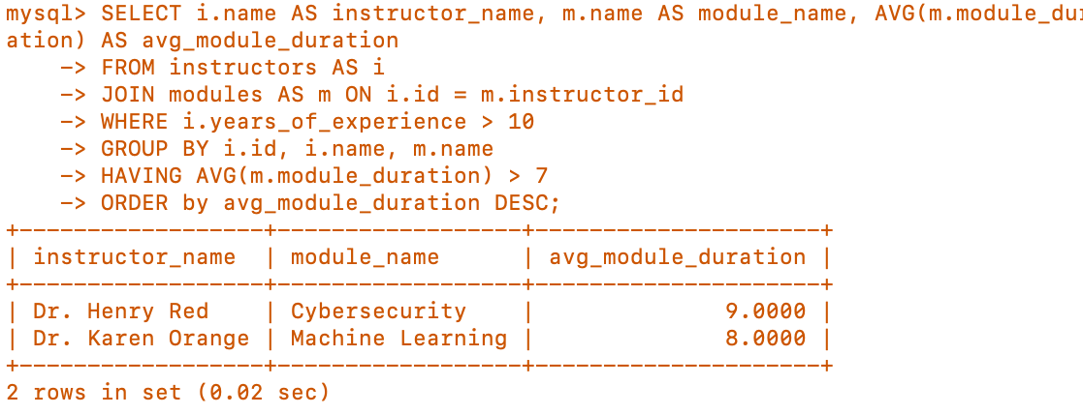
Aggregate Functions
Identify instructors with at least 10 years of teaching experience and an average module duration exceeding 7 hours

Slide 16
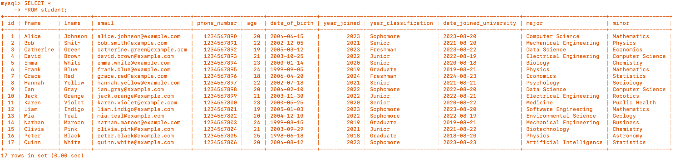
Normalizations
Student table
Functional Dependencies
date_of_birth -> age
year_joined -> year_classification
1 NF (All attributes related to 1NF)
2 NF (No partial dependency)
3 NF (No transitive dependencies)

Slide 17
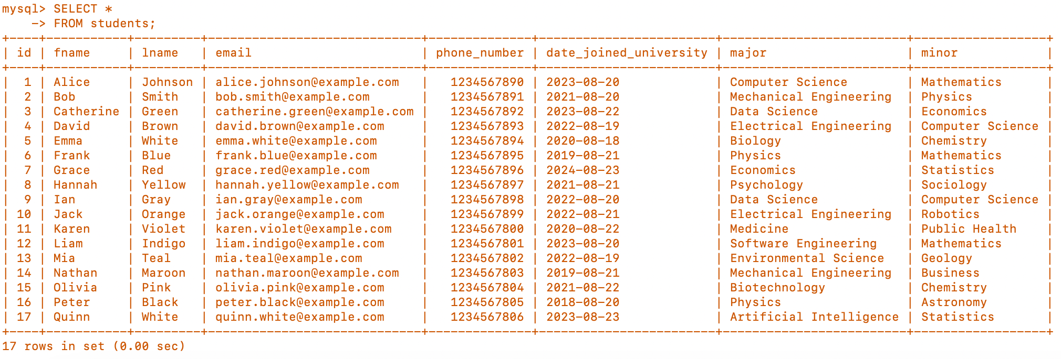
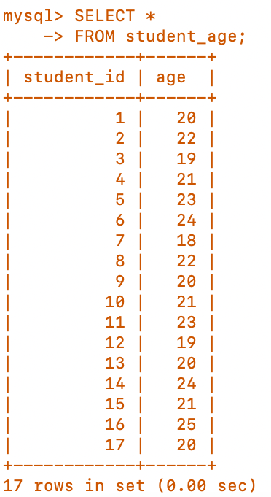
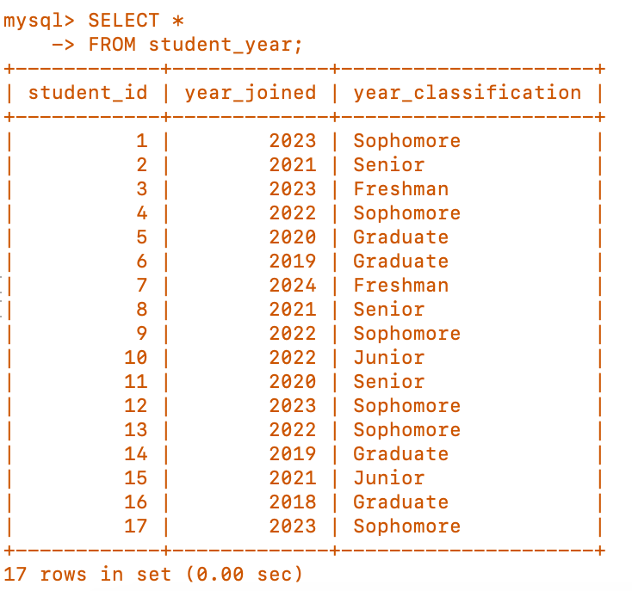
Normalizations
Break into three smaller tables (students, student_age, student_year)
3 NF (no transitive dependencies)

Slide 18
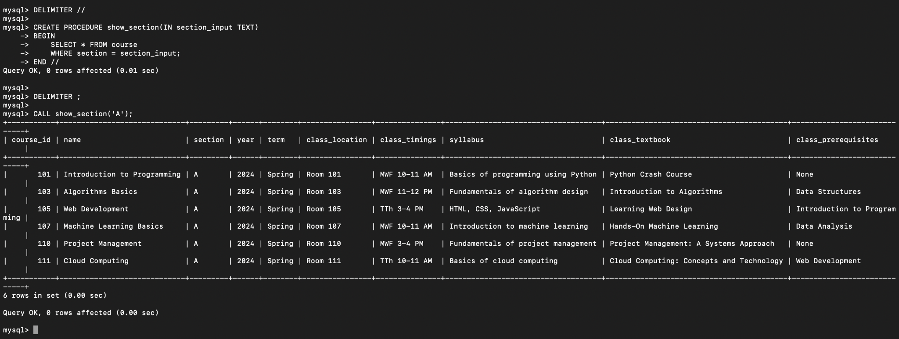
Stored Procedures
This figure executes a stored procedure that retrieves all rows from the course table for a specified section. In this example, the section is ‘A’.

Slide 19
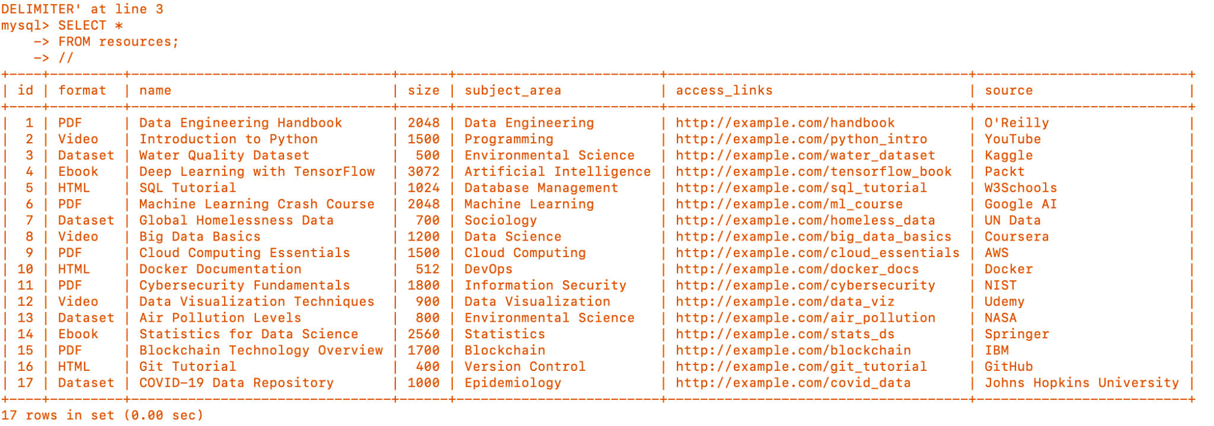
Stored Procedures 2
Procedure taking new sets of data with the given parameter and insert them into resources table
Initial Resources table output as shown below

Slide 20
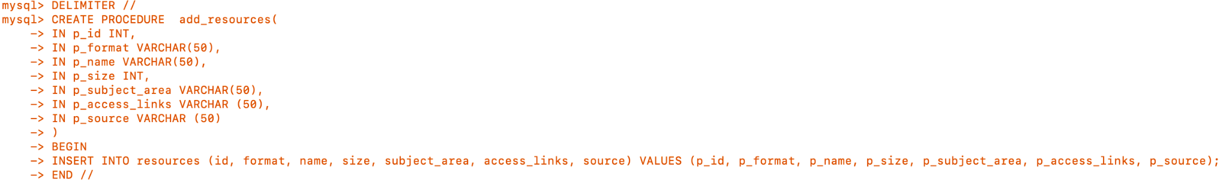
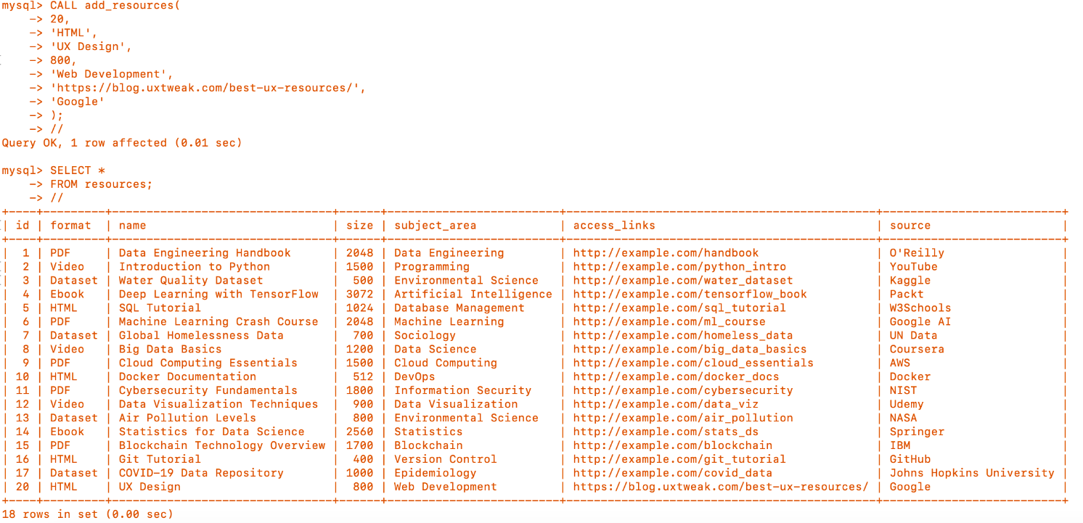
Stored Procedures 2
New Updated Resources Table

Slide 21
Challenges & Approach
Krish’s Learnings
Rachel’s Learnings
Identified missing columns from entities when generating tables
Organized the data tables better
Performed Joins
Learned that this can help organize the data
More efficient and reduce redundancy
Designing phase is flexible (drop primary & secondary residence)
Difficulty working synchronously
Ensure data consistency

Slide 22
Conclusion
Recognized the importance of remaining organized
Seek feedback from others to uncover room for improvement
Revising tables to improve data readability (removing NULLs)
Identifying Ternary relationships in a large database system

Slide 23

December 4, 2024
THANK YOU

